Slide 1
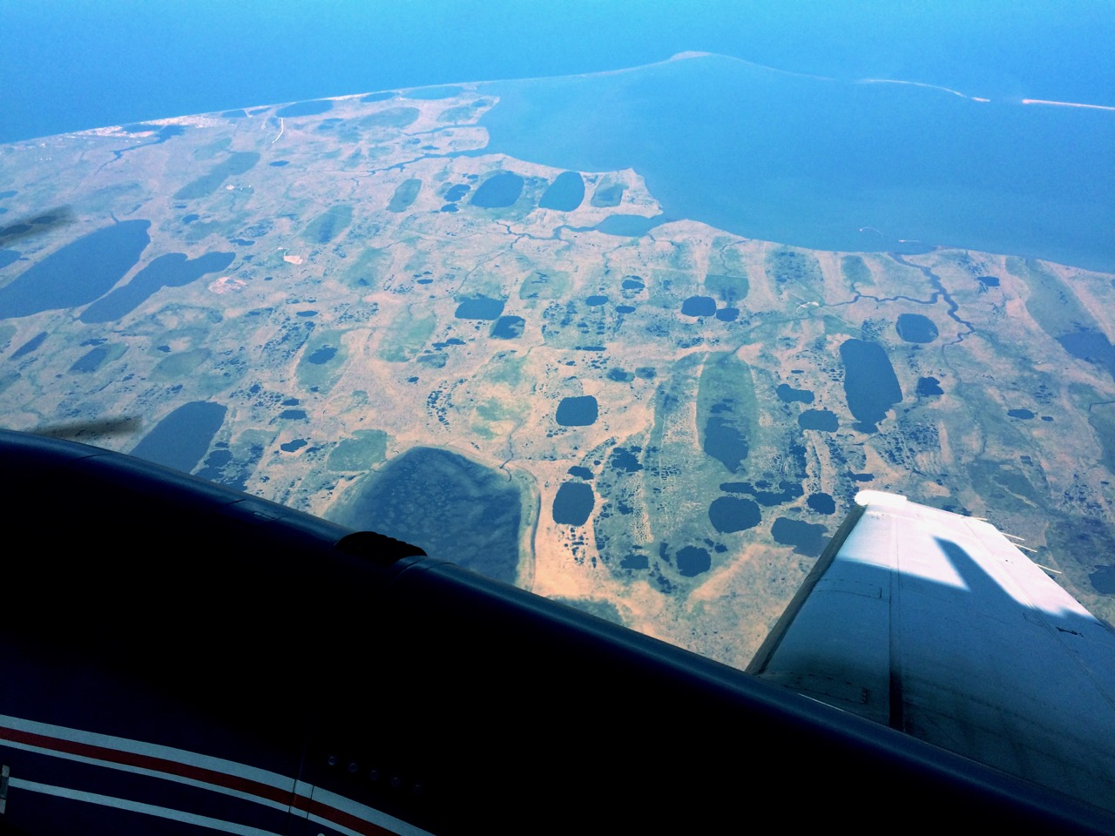

Arctic Boreal Vulnerability Experiment (ABoVE)
Airborne Campaigns
Charles Miller, Deputy Science Lead
Jet Propulsion Laboratory, California Institute of Technology
Peter Griffith, ABoVE Project Manager
and the ABoVE Science Team
Terrestrial Ecology PI Meeting, College Park MD, 25 Sep 2019

Slide 2
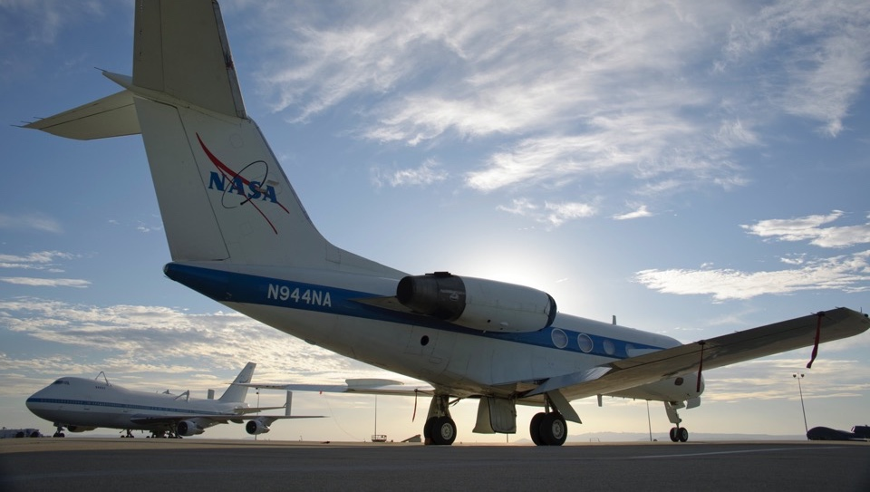
ABoVE Airborne Campaigns
Goals:
Provide domain-wide context to unify site-level process studies
Probe difficult to measure intermediate spatial scales
Link to satellite remote sensing
Demonstrate new remote sensing technologies and multi-sensor data analyses

Slide 3
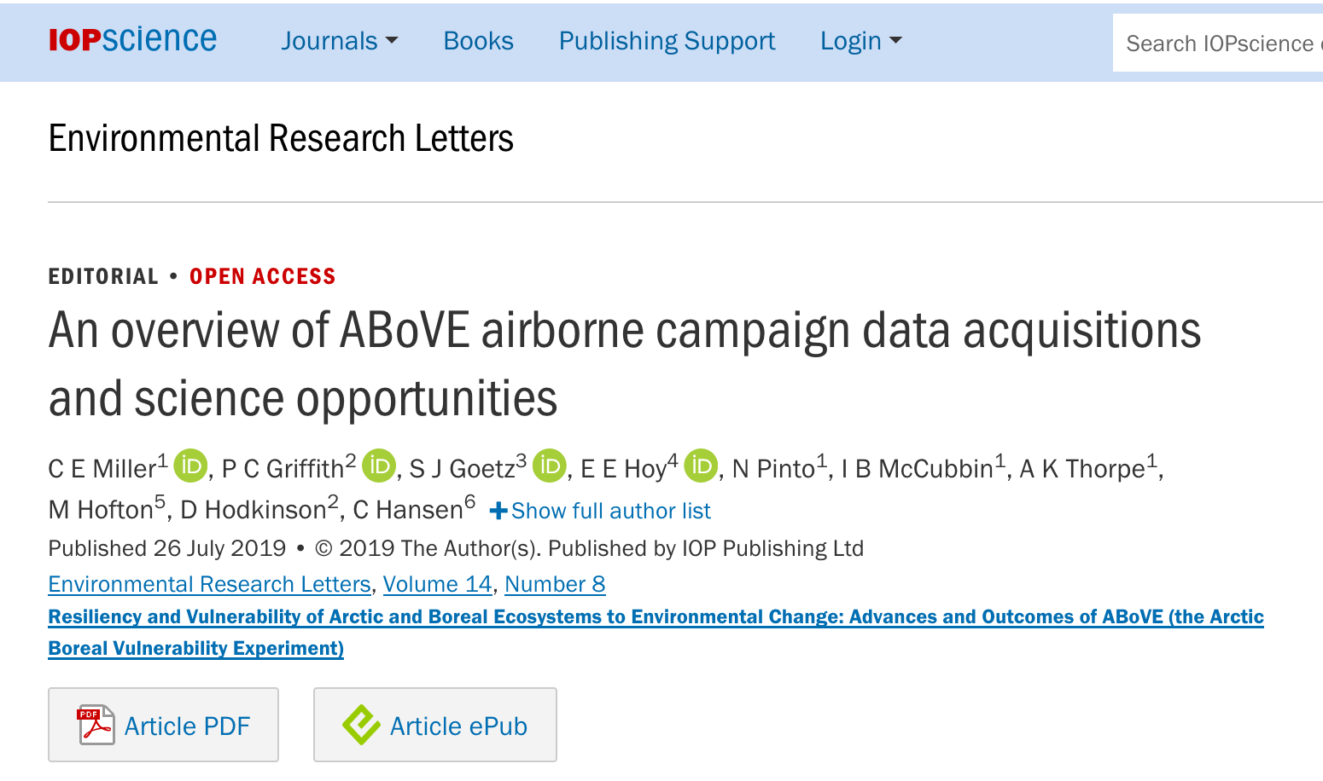

Slide 4
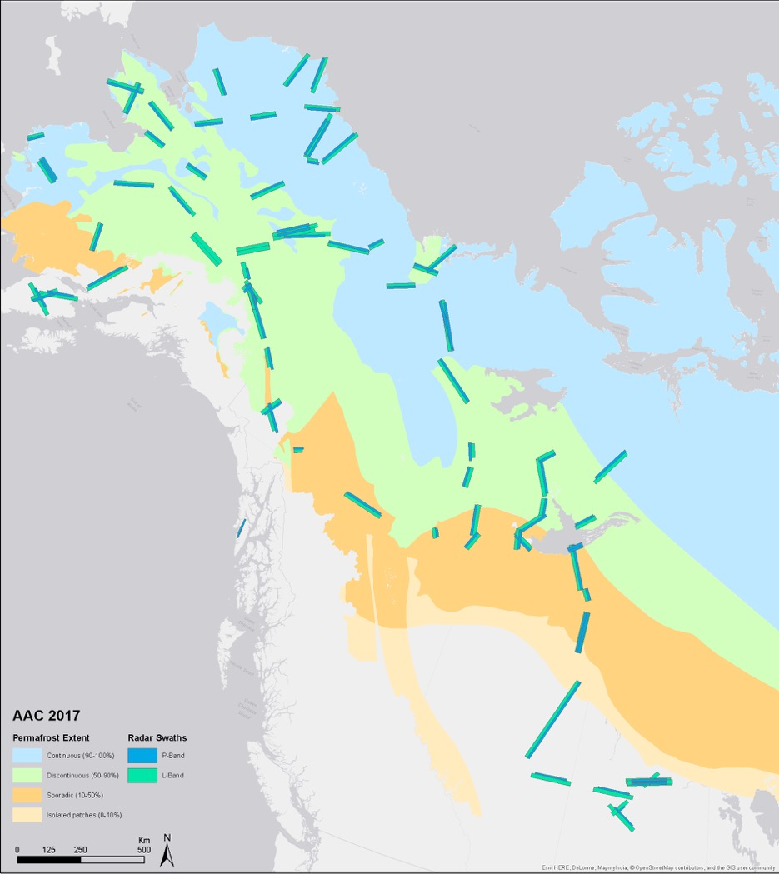
2017 AAC flight lines developed based on careful consideration of all objectives and requirements
SAR flight lines serve as framework & sample important ground truth sites
Cover bioclimatic gradients across ABoVE domain (~4M km2)
Lines & grids modified as needed for for PI-led projects
2017: L-band SAR, AVIRIS, LVIS, AirSWOT, CFIS, Arctic-CAP, ASCENDS, P-band SAR
2018: L-band SAR, AVIRIS
2019: L-band SAR, AVIRIS, LVIS
2020: L-band SAR, AVIRIS (TBC)
2021: SnowEx-ABoVE (TBC)
Miller et al., ERL (2019)

Slide 5
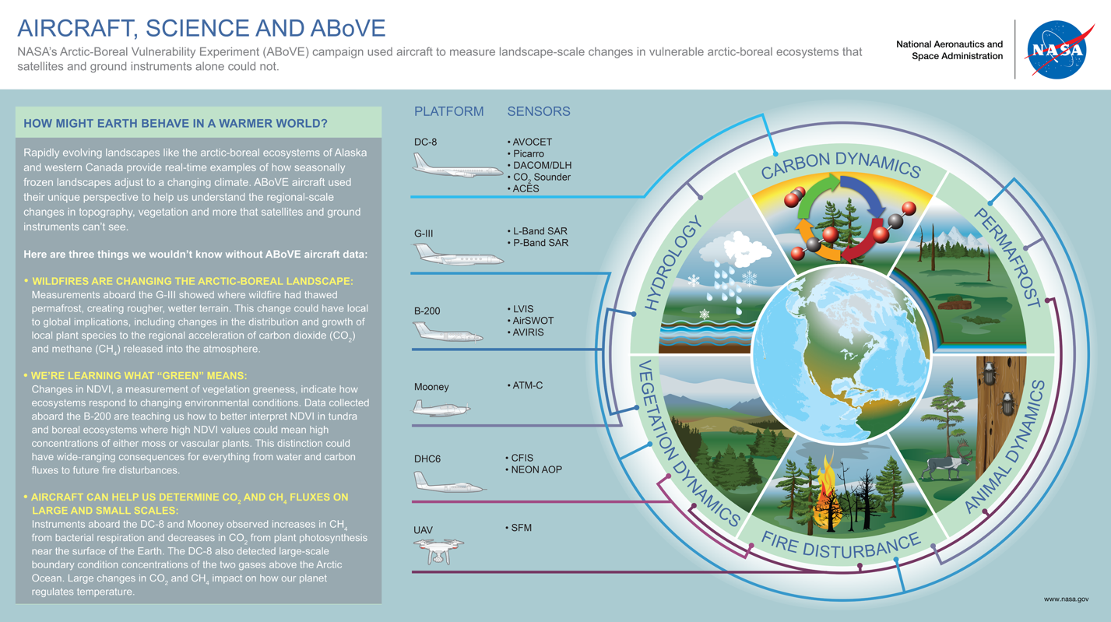
http://above.nasa.gov/airborne

Slide 6
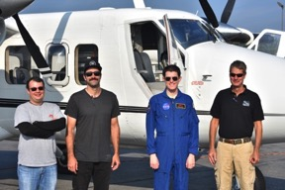
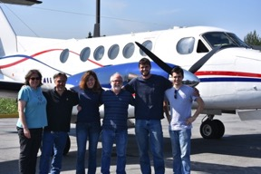
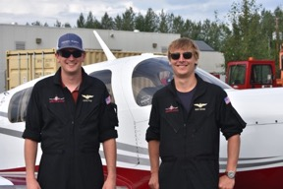
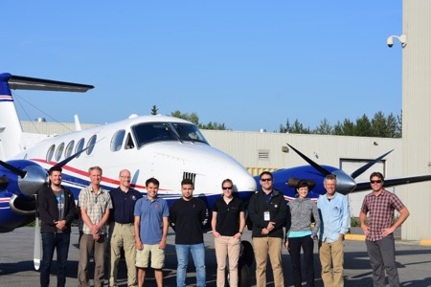
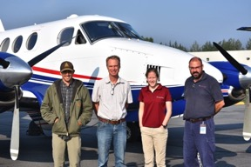
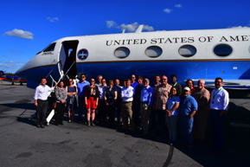
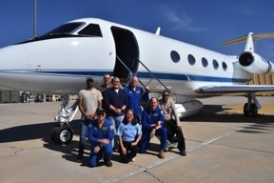
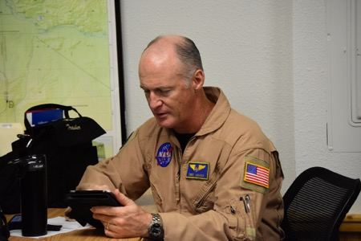
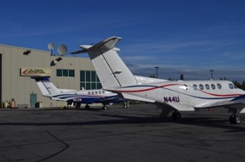
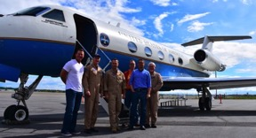
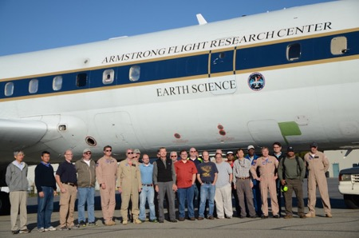
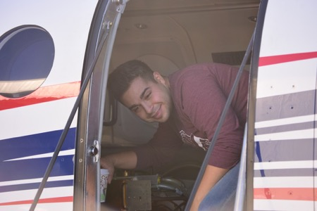
2017 - 2018 ABoVE Airborne Teams

Slide 7
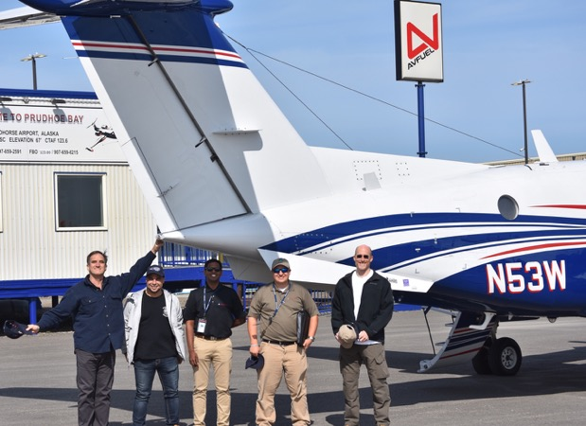
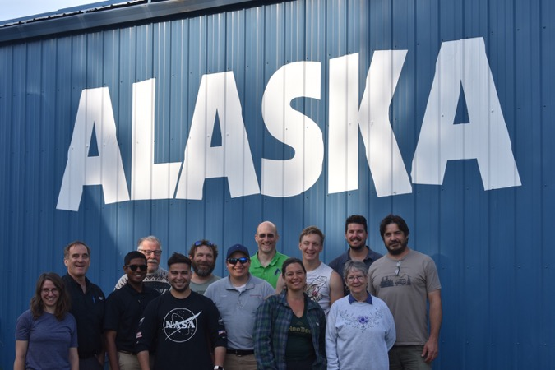
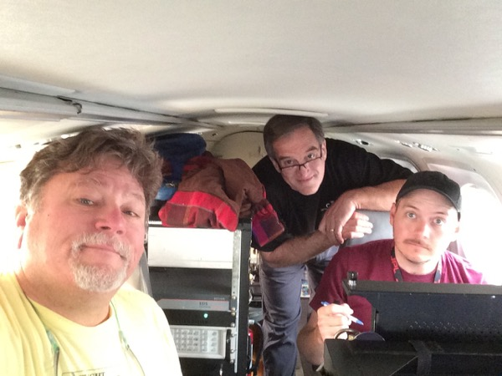
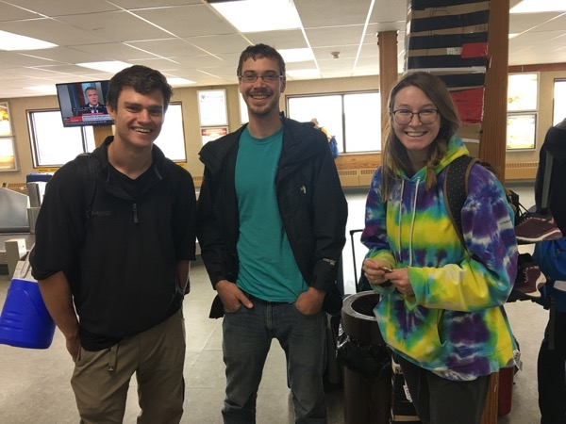
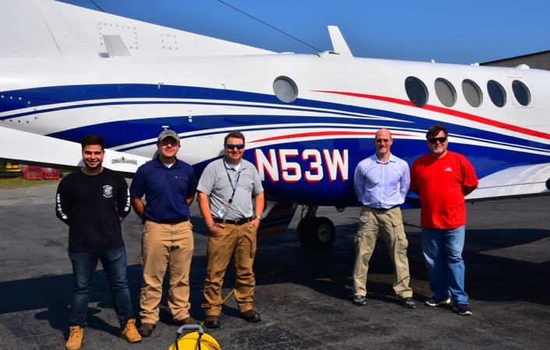
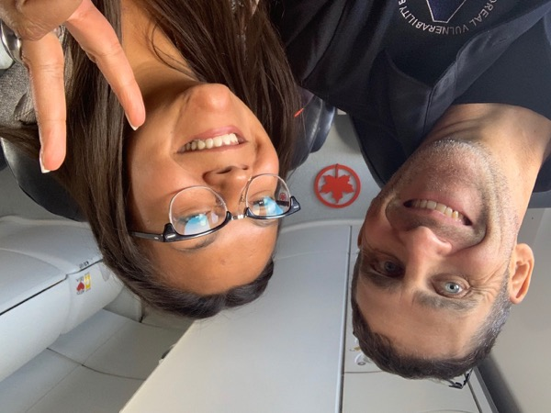
2019 ABoVE Airborne Teams

Slide 8
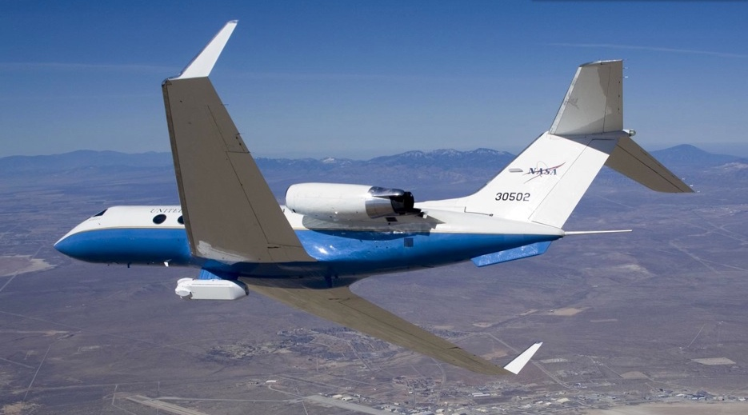
ABoVE SAR Remote Sensing

Slide 9
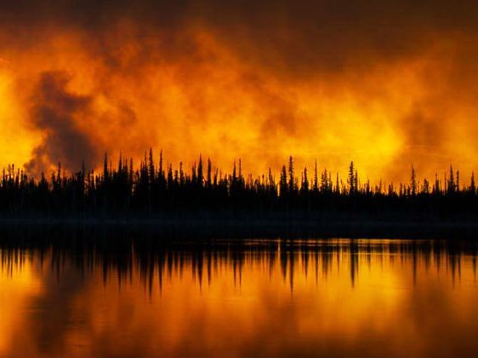
Fire Disturbance, Permafrost,
Carbon & Hydrology
2014 Fires Raging near Yellowknife

Slide 10
ABoVE Flight Lines Sample
2014 & 2015 Burned Areas
X Walker et al., Nature (2019)

Slide 11
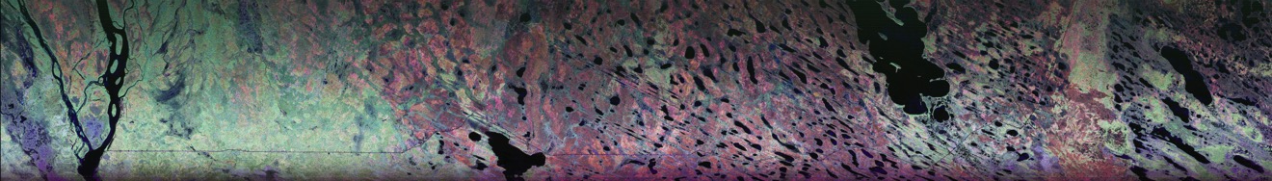
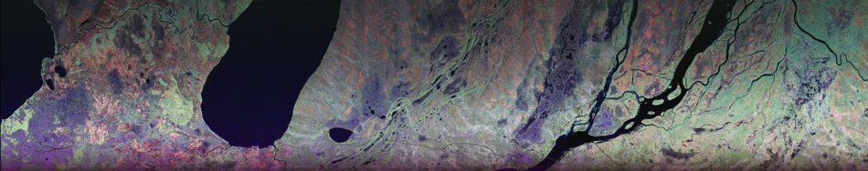
Polarized SAR Mapping of Boreal Fire Disturbance: Great Slave Lake Region
Fort Providence
Kakisa Lake

Slide 12
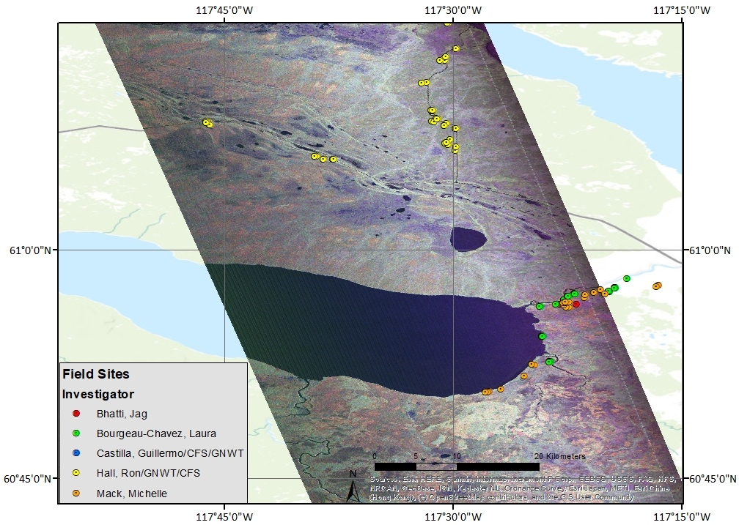
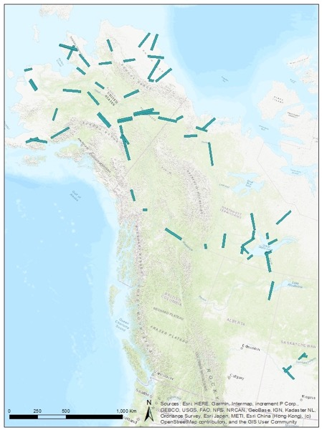
5 Sep 2019: kakisB_34809
Kakisa Lake
P Griffith & L Hoy

Slide 13
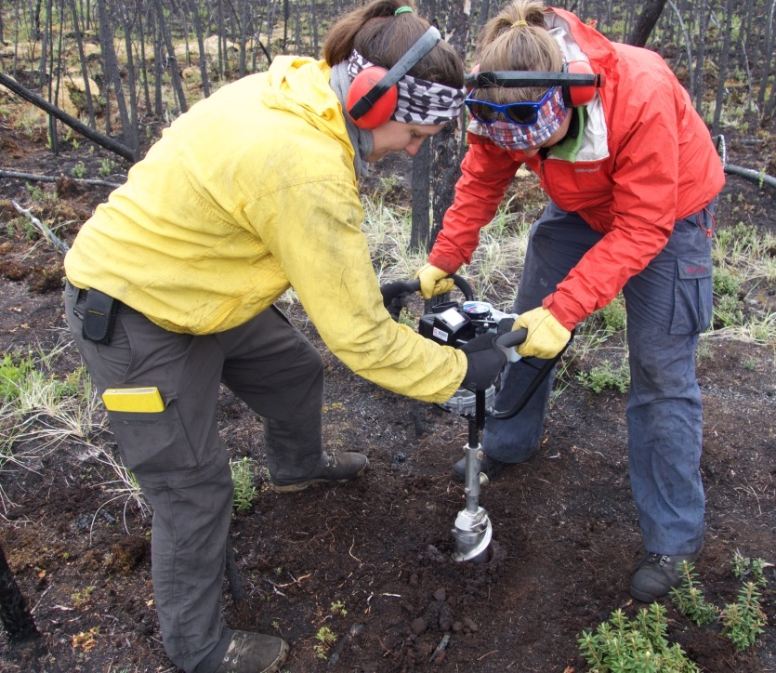
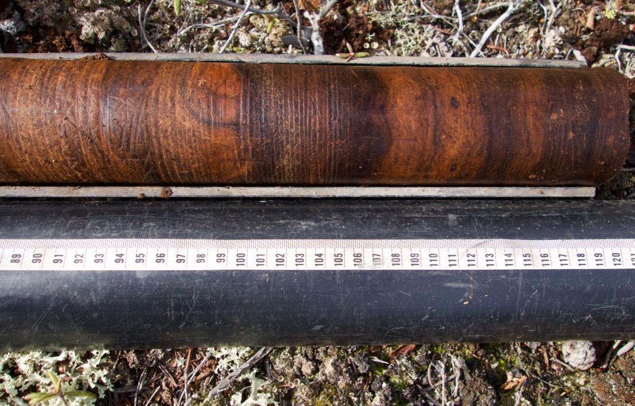
ABoVE Field Work Ties
Fire Severity to Remote Sensing
Permafrost core from a fire burn scar near Yellowknife NT (M Turetsky)
Permafrost coring at a fire burn scar near Yellowknife NT (M Turetsky)

Slide 14
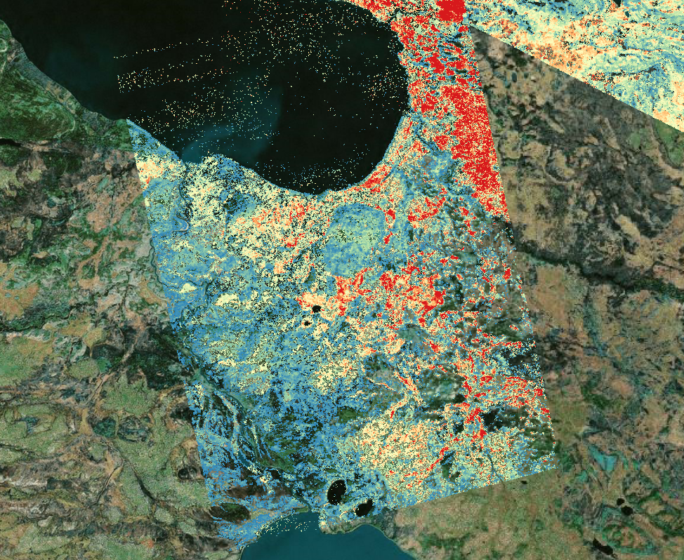
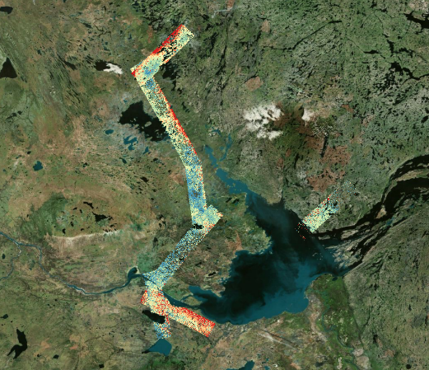

L-band SAR Observations of
Fire-induced Subsidence: Kakisa Lake
Burned
Unburned
K Schaefer
Subsidence (cm)

Slide 15
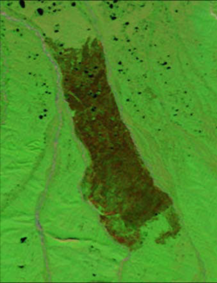
InSAR Characterization of the
2007 Anukutuvuk River Fire Scar
100 km
MODIS
Aug 2008
P-band SAR composite image of the Anaktuvuk River fire scar reveals accelerated permafrost degradation through increased roughness and thermokarsting in burned (light green) vs unburned (dark green) landscape

Slide 16
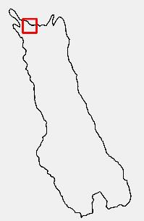
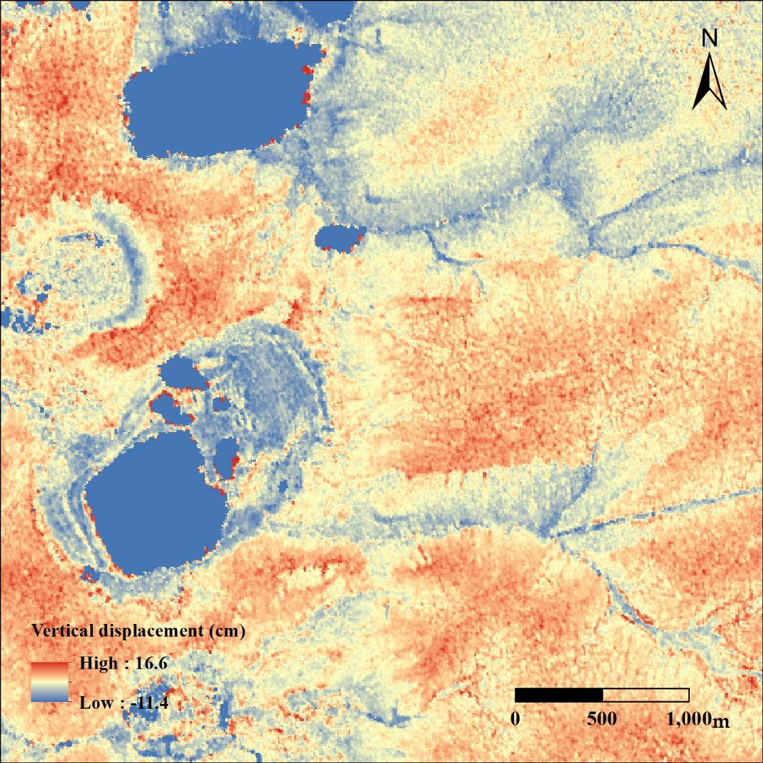
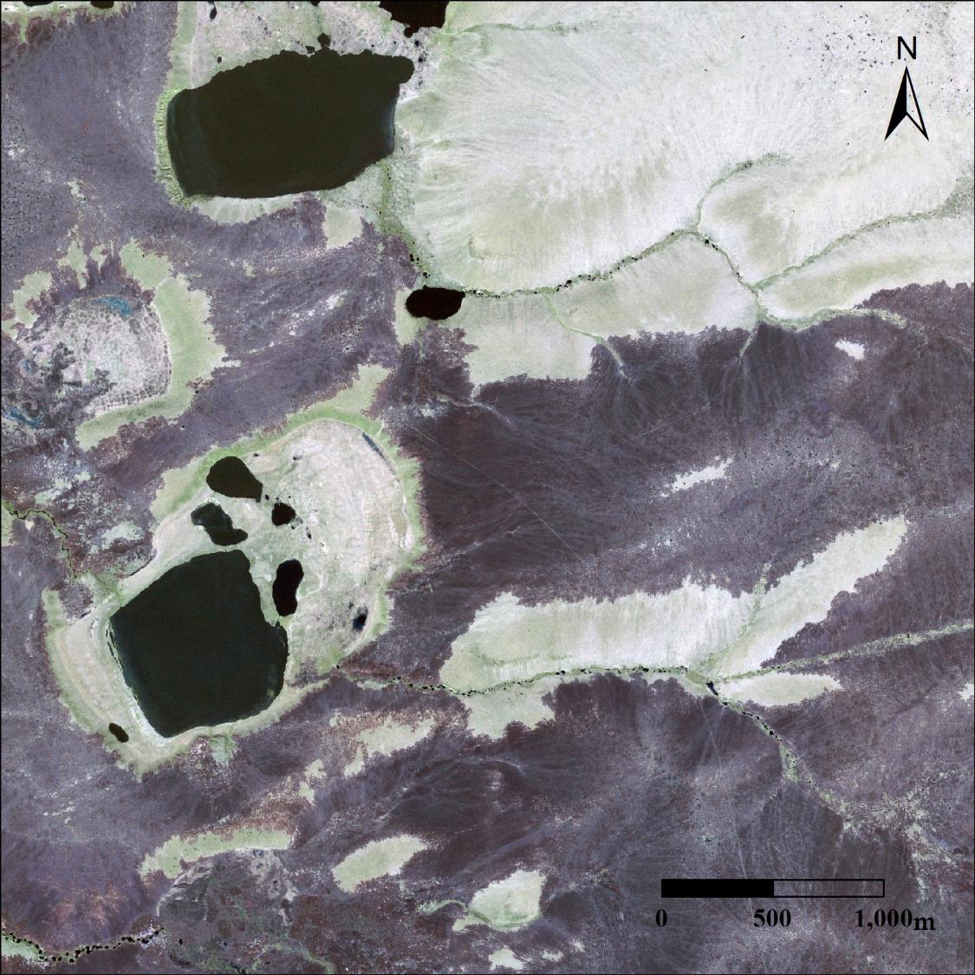
L-band InSAR Quantifies Increased Subsidence in ARFS Burn Areas
Unburned
Burned
G Iwahana
L-Band SAR Interferogram:
2017, Jun 21 → 2017, Sep 16
DEM: SRTM30 v2
Wave length: 23.84cm
SLC spacing: 0.6m x 1.67m
MLI: 7.2 x 5.0m (12 x 3 looks)
7.2 x 7.5m (in ground)
Quickbird Optical Imagery:
3 July 2008

Slide 17
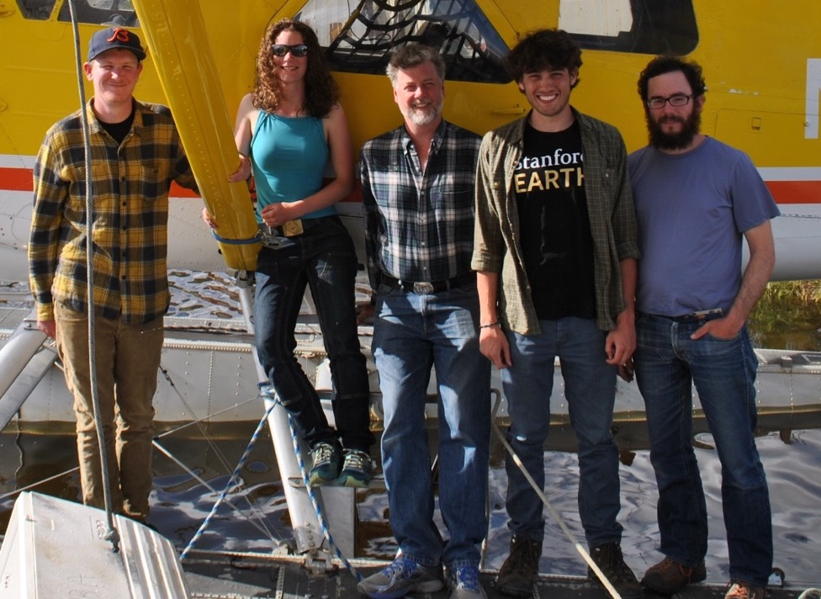
YK Deltat Field Data Confirm Accelerated Permafrost Degradation in Burn Scars
K Schaefer,
Univ Colorado
K Schaefer & Team

Slide 18
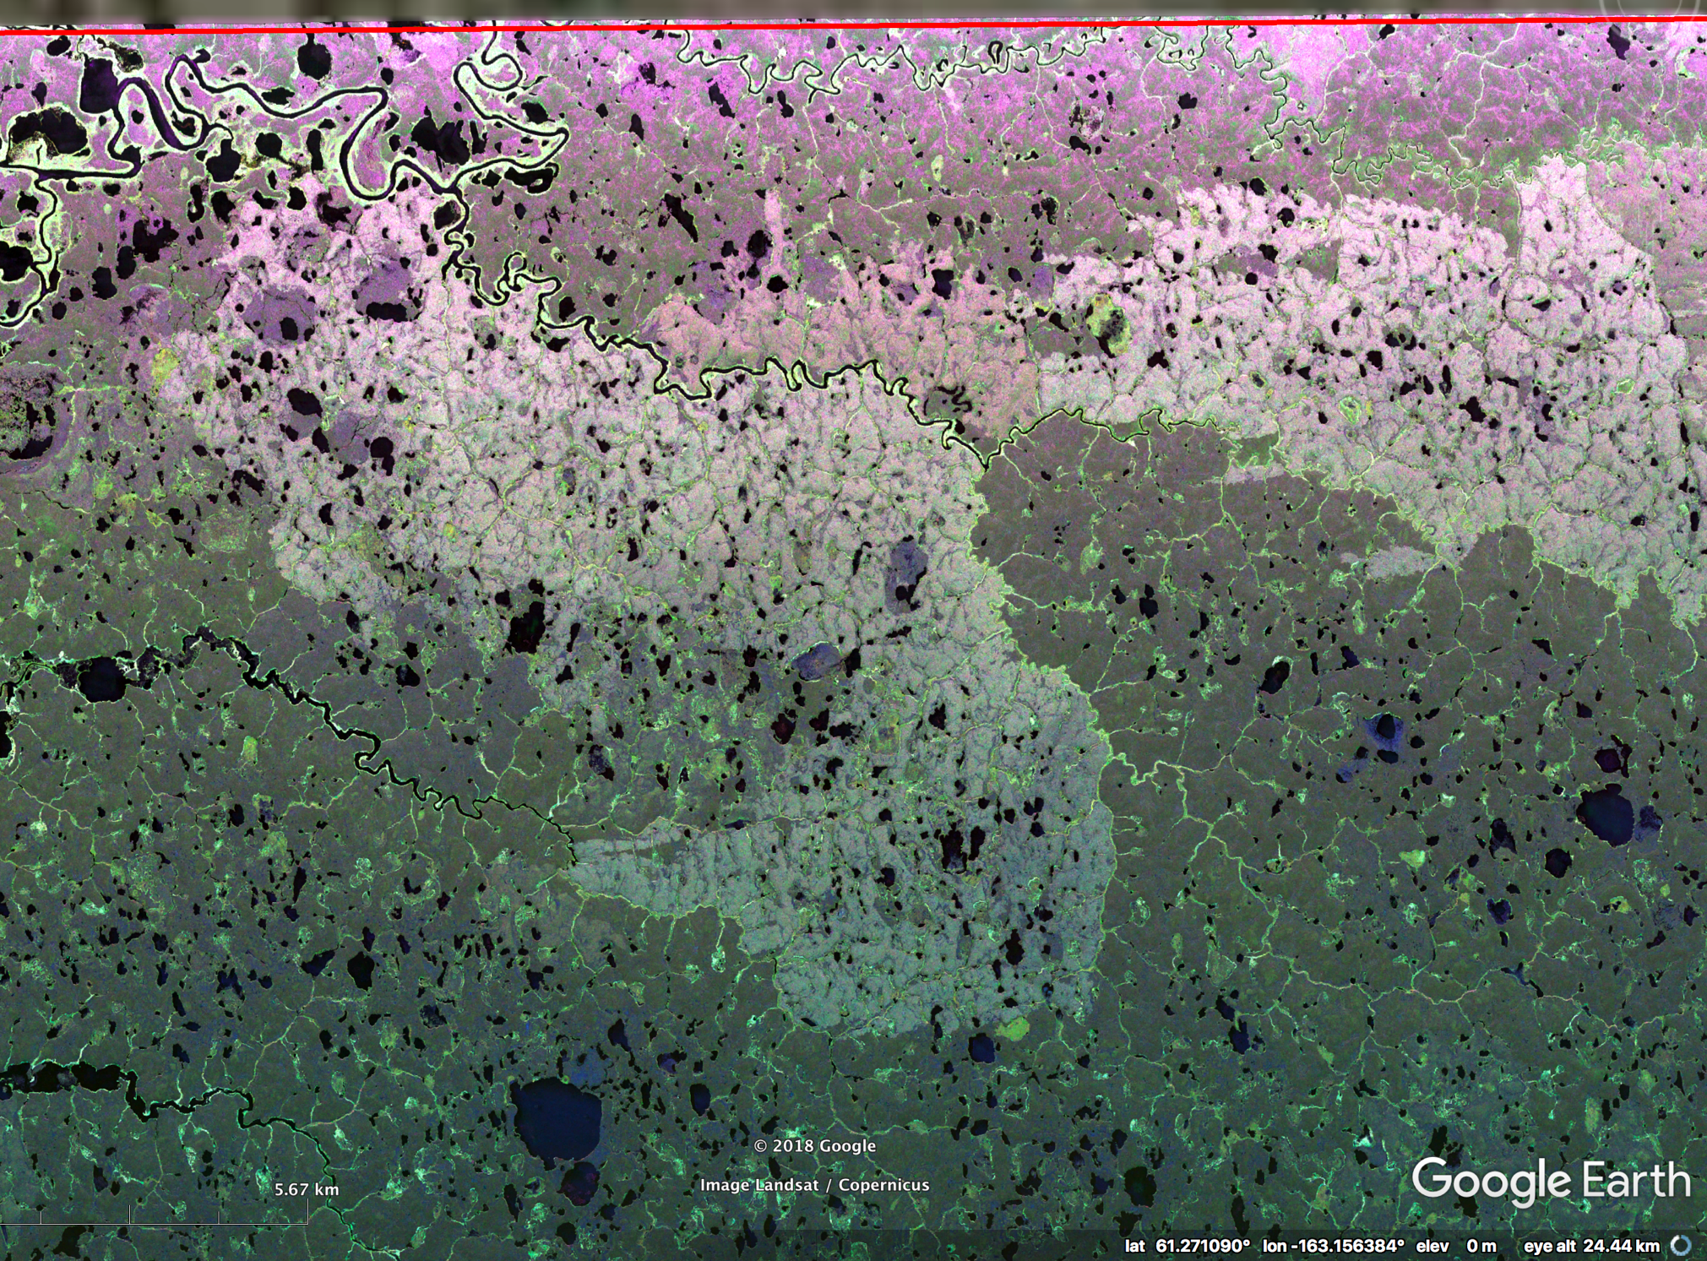
Bigmouth Lake Fire
(2015)
L-Band SAR
28 Aug 2018
Line 26905
YK Delta Fire Scars

Slide 19
AVIRIS- NG Composite – July 2018
Bigmouth Lake Fire
(2015)

Slide 20
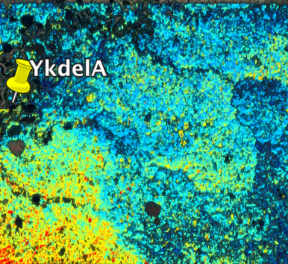
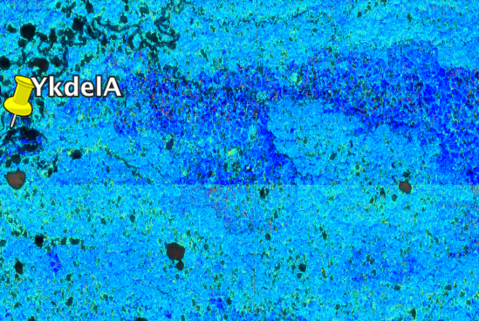
2015 YK Tundra Fire Deepens ALT & Increases Soil Moisture
Active Layer Thickness
Volumetric Soil Moisture
K Schaefer

Slide 21
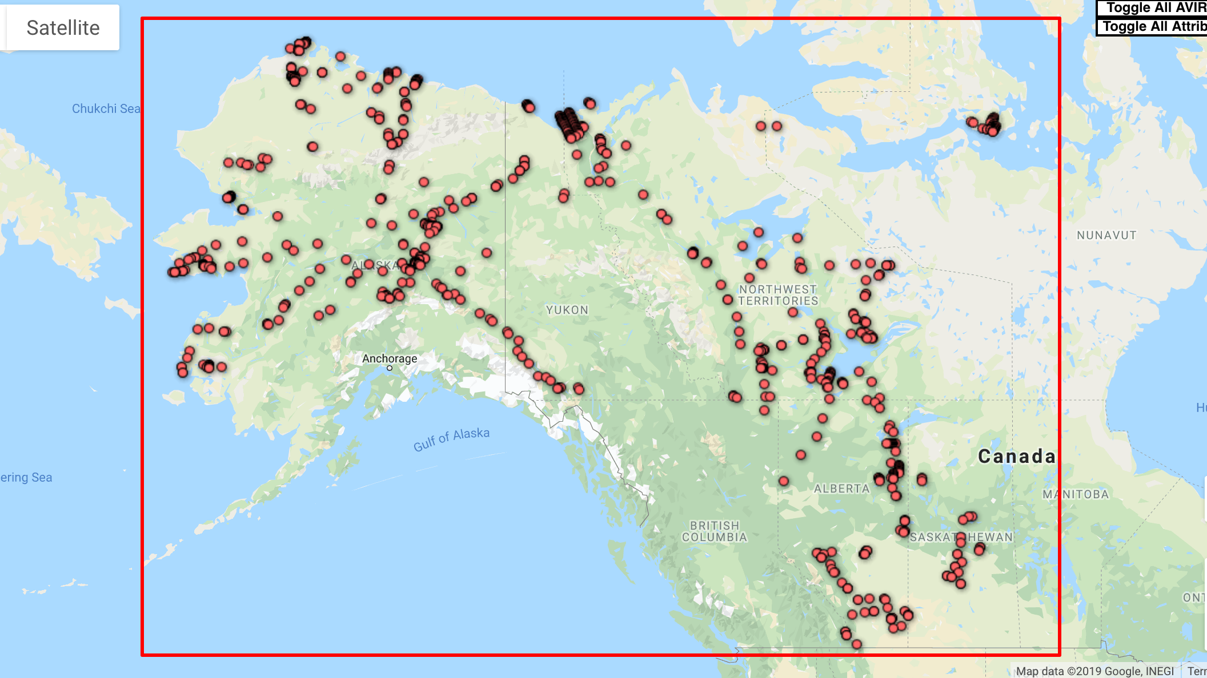
2018 AVIRIS-NG Flight Lines
ABoVE AVIRIS-NG
Data Acquisitions
2017-2019

Slide 22
12 July 2019/DOY 193: Barrow
M Eastwood

Slide 23
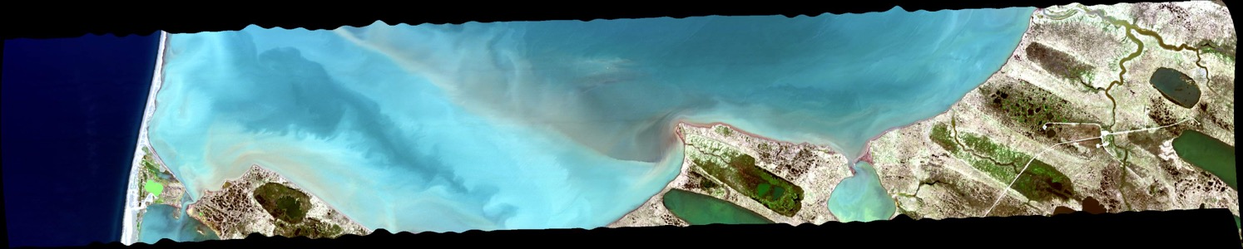
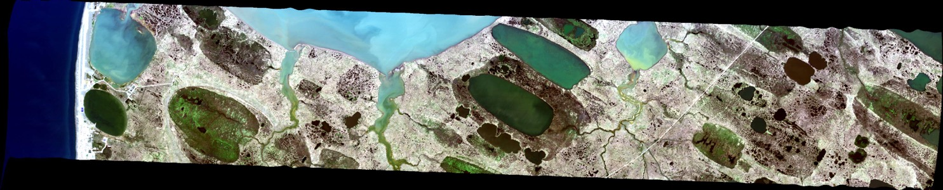
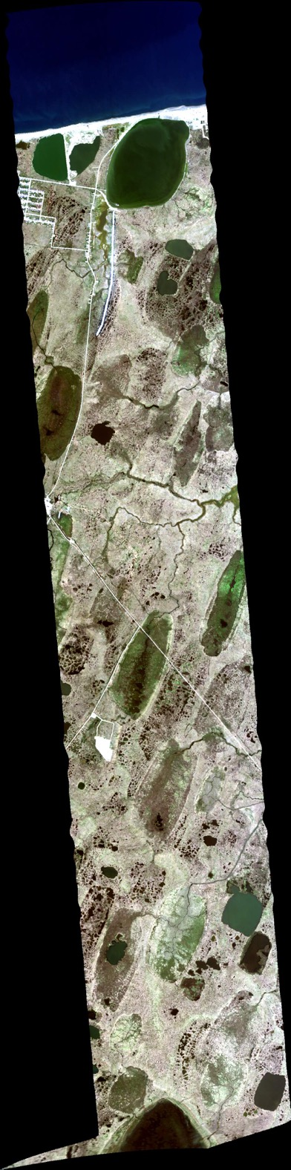
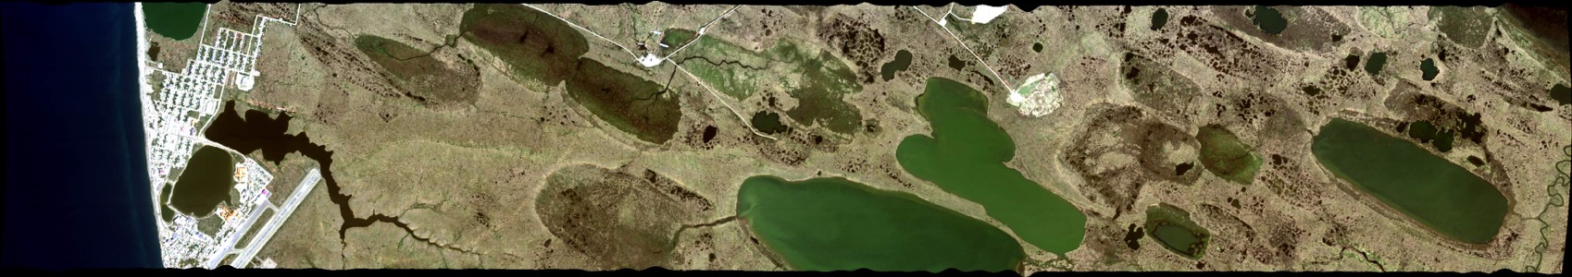
7/12/2019 Barrow Area Composite

Slide 25
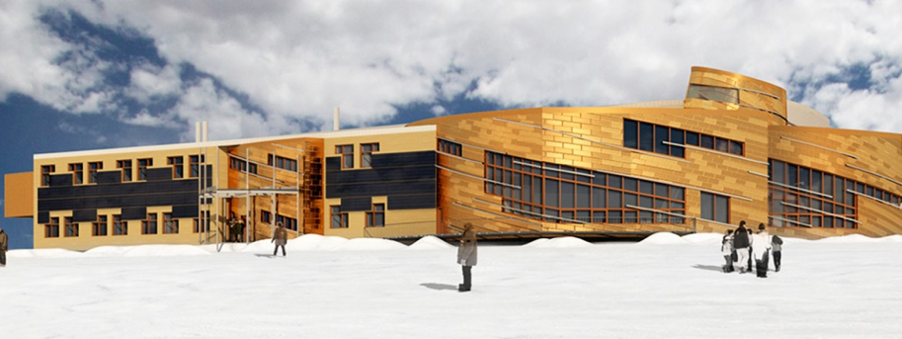
3 Aug 2017/DOY 215
Polar Knowledge Canada’s
Canadian High Arctic Research Station (CHARS)

Slide 26
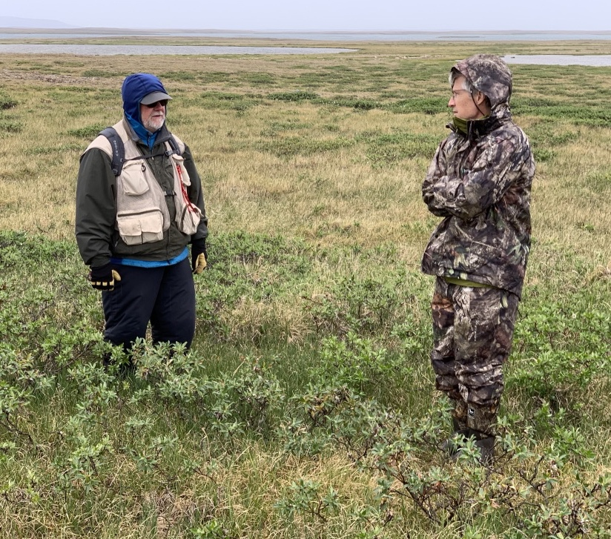
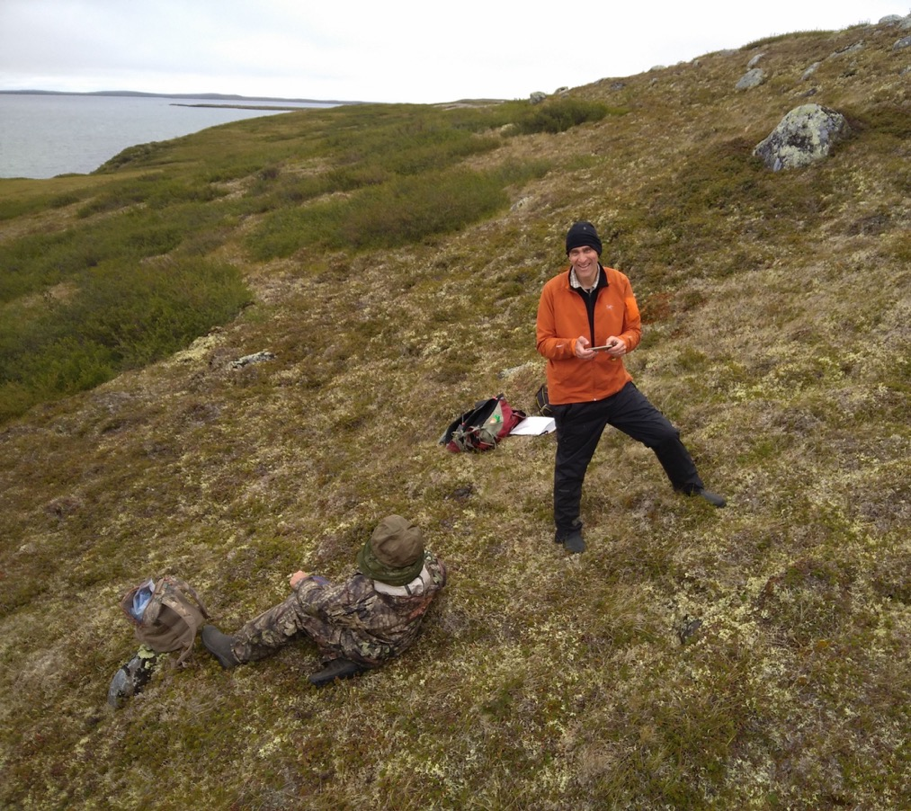
1 August 2019: Summer Field Work @CHARS – Cambridge Bay
Donald McLennan and Eric Kruger
Phil Townsend and Eric Kruger

Slide 27
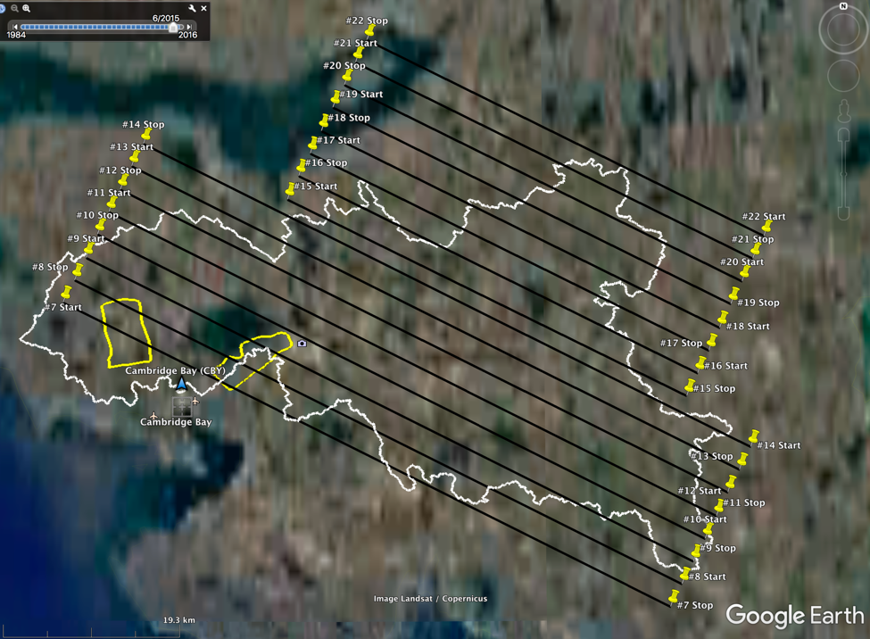

1 August 2019/DOY 213
CHARS – Cambridge Bay Gird #1
CHARS Greiner Watershed
Planned Flight Lines
CHARS Greiner Watershed
As-Flown Lines

Slide 28
1 August 2019/DOY 213
CHARS – Cambridge Bay Gird #1
The community of Cambridge Bay, the airport, and the SW edge of the Greiner Watershed imaged in Lines 23-25

Slide 29

1 August 2019/DOY 213
CHARS – Cambridge Bay Gird #1
AVIRIS RGB Composite
CHARS Watershed
F Schneider, P Townsend

Slide 30

1 August 2019/DOY 213
CHARS – Cambridge Bay Gird #1
AVIRIS NIR Composite
CHARS Watershed
F Schneider, P Townsend

Slide 31

1 August 2019/DOY 213
CHARS – Cambridge Bay Gird #1
AVIRIS Minimum Noise Fraction
CHARS Watershed
Much more information content than RGB or NIR composites might suggest
F Schneider, P Townsend

Slide 32

1 August 2019/DOY 213
CHARS – Cambridge Bay: Lignin
F Schneider, P Townsend

Slide 33

1 August 2019/DOY 213
CHARS – Cambridge Bay: Canopy N
F Schneider, P Townsend

Slide 34

1 August 2019/DOY 213
CHARS – Cambridge Bay: Canopy N
F Schneider, P Townsend
Red: LMA (leaf mass per area) Green: % Nitrogen Blue: % Lignin

Slide 35

CHARS High-resolution
Ecosystem Classification
Ponomarenko (2019)

Slide 36

AVIRIS Mapped CH4 Enhancements
Mackenzie Delta
C Elder, D Thompson,
A Thorpe

Slide 37

AVIRIS Mapped CH4 Enhancements
Mackenzie Delta
C Elder

Slide 38

2 July 2019 - Kluane Lake, YT
Spruce Beetle Infestation & Mortality
Campbell (2019)
F Schneider

Slide 39


16 July 2019/DOY 197
Sortie 2: Yellowknife Area INAC Sites
Yellowknife Area
INAC Sites
As-Flown Lines
2019 AVIRIS
Yellowknife Area INAC sites

Slide 40


16 July 2019/DOY 197
Sortie 2: Yellowknife Area INAC Sites
Gordon Lake Area Composite
& INAC Remediation Sites
Knight Bay
(Kidney Pond)
Storm
Property
Knight Bay
(Treacy No,. 1)
Burn Island
Camlaren Mine
(Hump Vein)
Goodrock Mine
West Bay Mine
(Black Ridge)

Slide 41

AVIRIS-NG Mapping of the
NGEE-Arctic Council AK Watershed

Slide 42

S Serbin

Slide 43
S Serbin

Slide 44

2019 LVIS Flight Lines & QA
Color key:
Red = zero
Pink = 1 to 10%
Orange >10 to 20%
Yellow >20 to 50%
Green >50% surface returns
Notes:
NASA5 and the LVIS team conducted science sorties (91 flight hours), including during the two transit legs, between 12 July and 7 August 2019 for the Arctic-Boreal Vulnerability Experiment. Targets requested by the Science Team included TomoSAR swaths at BERMS and Delta Junction for NISAR; underflights of IceSAT-2 Reference Ground Tracks; first-time observations and revisits of L-ban SAR swaths across the ABoVE domain for the Active Layer Working Group; opportunistic data acquisition of the Shovel Creek fire perimeter near Fairbanks, including reflights of an line flown in 2014 by G-LiHT; NGEE-Arctic sites in Barrow and the Seward Peninsula; and numerous burn scars around Yellowknife/Great Slave Lake for the Phase 2 Wildfire projects. Weather provided daily challenges to acquisition, but due to the excellent performance of the LVIS instruments and NASA5’s extended range and duration, in the end, the only targets not acquired were the Anaktuvuk Burn Scar on the North Slope of Alaska, and two SAR swaths on the Yukon-Kuskokwim Delta.

Slide 45

Approximate 2015 G-LiHT track
LVIS Acquisitions across
2019 Shovel Creek Fire Perimeter
Near Fairbanks

Slide 46

B Blair, M Hofton
LVIS over Delta Junction AK TomoSAR Acquisitions

Slide 47

Questions
Charles.E.Miller@jpl.nasa.gov
https://above.nasa.gov/airborne/index.html

Slide 48

Backup

Slide 49


Slide 50


Slide 51


SAR Observations of
Trans-boundary Watersheds
Fort Smith
Slave River

Slide 52

8 Aug 2017
P-Band SAR – Slave Delta
Slave River Delta and outflow into the Great Slave Lake

Slide 53

NWT First Nations Students Experience ABoVE Airborne Science
Cabin Radio
https://cabinradio.ca/8862/news/environment/aboard-nasa-jet-sahtu-students-prepare-to-protect-the-land/

Slide 54

KTOO Public Media
https://www.ktoo.org/2018/08/30/in-the-air-with-nasa-studying-environmental-change-from-40000-feet/

Slide 55


The ABoVE BBQ Tradition Continues

